Slide 1
Building Java Programs Supplement 3G
Graphics

Slide 2
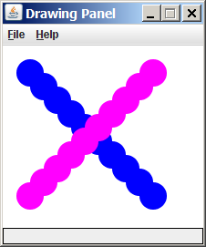
Graphical objects
We will draw graphics in Java using 3 kinds of objects:
DrawingPanel: A window on the screen.
Not part of Java; provided by the authors. Check it on the internet.
Graphics: A "pen" to draw shapes and lines on a window.
Color: Colors in which to draw shapes.

Slide 3
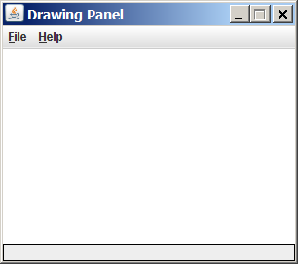
DrawingPanel
"Canvas" objects that represents windows/drawing surfaces
To create a window:
DrawingPanel name = new DrawingPanel(width, height);
Example:
DrawingPanel panel = new DrawingPanel(300, 200);
The window has nothing on it.
We draw shapes / lines on it with another object of type Graphics.

Slide 4
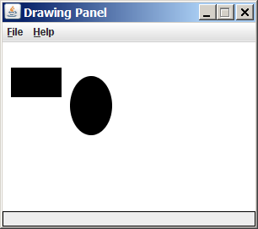
Graphics
"Pen" or "paint brush" objects to draw lines and shapes
Access it by calling getGraphics on your DrawingPanel.
Graphics g = panel.getGraphics();
Draw shapes by calling methods on the Graphics object.
g.fillRect(10, 30, 60, 35);
g.fillOval(80, 40, 50, 70);

Slide 5
Java class libraries, import
Java class libraries: Classes included with Java's JDK.
organized into groups named packages
To use a package, put an import declaration in your program:
// put this at the very top of your program
import packageName.*;
Graphics belongs to a package named java.awt
import java.awt.*;
To use Graphics, you must place the above line at the very top of your program, before the public class header.

Slide 6
Coordinate system
Each (x, y) position is a pixel ("picture element").
Position (0, 0) is at the window's top-left corner.
x increases rightward and the y increases downward.
The rectangle from (0, 0) to (200, 100) looks like this:
(0, 0) x+
(200, 100)
y+

Slide 7
Graphics methods
Method name | Description
g.drawLine(x1, y1, x2, y2); | line between points (x1, y1), (x2, y2)
g.drawOval(x, y, width, height); | outline largest oval that fits in a box of size width * height with top-left at (x, y)
g.drawRect(x, y, width, height); | outline of rectangle of size width * height with top-left at (x, y)
g.drawString(text, x, y); | text with bottom-left at (x, y)
g.fillOval(x, y, width, height); | fill largest oval that fits in a box of size width * height with top-left at (x, y)
g.fillRect(x, y, width, height); | fill rectangle of size width * height with top-left at (x, y)
g.setColor(Color); | set Graphics to paint any following shapes in the given color

Slide 8
Color
Specified as predefined Color class constants:
Color.CONSTANT_NAME
where CONSTANT_NAME is one of:
BLACK, BLUE, CYAN, DARK_GRAY, GRAY, GREEN, LIGHT_GRAY, MAGENTA, ORANGE, PINK, RED, WHITE, YELLOW
Or create one using Red-Green-Blue (RGB) values of 0-255
Color name = new Color(red, green, blue);
Example:
Color brown = new Color(192, 128, 64);

Slide 9
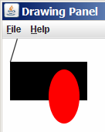
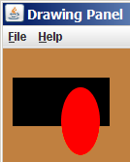
Using colors
Pass a Color to Graphics object's setColor method
Subsequent shapes will be drawn in the new color.
g.setColor(Color.BLACK);
g.fillRect(10, 30, 100, 50);
g.drawLine(20, 0, 10, 30);
g.setColor(Color.RED);
g.fillOval(60, 40, 40, 70);
Pass a color to DrawingPanel's setBackground method
The overall window background color will change.
Color brown = new Color(192, 128, 64);
panel.setBackground(brown);

Slide 10
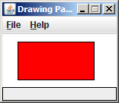
Outlined shapes
To draw a colored shape with an outline, first fill it, then draw the same shape in the outline color.
import java.awt.*; // so I can use Graphics
public class OutlineExample {
public static void main(String[] args) {
DrawingPanel panel = new DrawingPanel(150, 70);
Graphics g = panel.getGraphics();
// inner red fill
g.setColor(Color.RED);
g.fillRect(20, 10, 100, 50);
// black outline
g.setColor(Color.BLACK);
g.drawRect(20, 10, 100, 50);
}
}

Slide 11
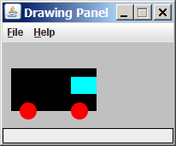
Superimposing shapes
When ≥ 2 shapes occupy the same pixels, the last drawn "wins."
import java.awt.*;
public class Car {
public static void main(String[] args) {
DrawingPanel panel = new DrawingPanel(200, 100);
panel.setBackground(Color.LIGHT_GRAY);
Graphics g = panel.getGraphics();
g.setColor(Color.BLACK);
g.fillRect(10, 30, 100, 50);
g.setColor(Color.RED);
g.fillOval(20, 70, 20, 20);
g.fillOval(80, 70, 20, 20);
g.setColor(Color.CYAN);
g.fillRect(80, 40, 30, 20);
}
}

Slide 12
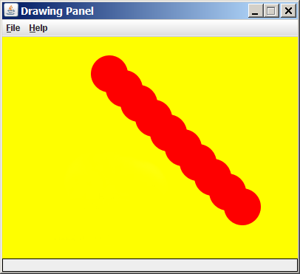
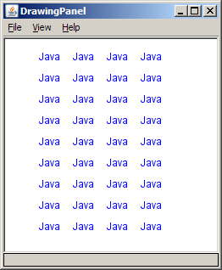
Drawing with loops
The x,y,w,h expressions can use the loop counter variable:
panel.setBackground(Color.YELLOW);
g.setColor(Color.RED);
for (int i = 1; i <= 10; i++) {
// x y w h
g.fillOval(100 + 20 * i, 5 + 20 * i, 50, 50);
}
Nested loops can be used with graphics:
g.setColor(Color.BLUE);
for (int x = 1; x <= 4; x++) {
for (int y = 1; y <= 9; y++) {
g.drawString("Java", x * 40, y * 25);
}
}

Slide 13
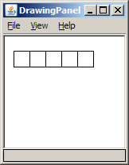
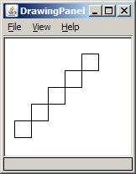
Zero-based loops
Beginning at 0 and using < can make coordinates easier.
DrawingPanel panel = new DrawingPanel(150, 140);
Graphics g = panel.getGraphics();
// horizontal line of 5 20x20 rectangles starting
// at (11, 18); x increases by 20 each time
for (int i = 0; i < 5; i++) {
g.drawRect(11 + 20 * i, 18, 20, 20);
}
Exercise: Write a variation of the above program that draws the output at right.
The bottom-left rectangle is at (11, 98).
for (int i = 0; i < 5; i++) {
g.drawRect(11 + 20 * i, 98 - 20 * i, 20, 20);
}

Slide 14
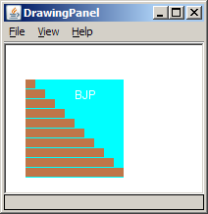
Java book figure
Write a program that draws the following figure:
drawing panel is size 200x150
book is at (20, 35), size 100x100
cyan background
white "BJP" text at position (70, 55)
stairs are in color (red=191, green=118, blue=73)
each stair is 9px tall
1st stair is 10px wide
2nd stair is 20px wide ...
stairs are 10px apart (1 blank pixel between)

Slide 15
Java book solution
// Draws a Building Java Programs textbook with DrawingPanel.
import java.awt.*;
public class Book {
public static void main(String[] args) {
DrawingPanel panel = new DrawingPanel(200, 150);
panel.setBackground(Color.WHITE);
Graphics g = panel.getGraphics();
g.setColor(Color.CYAN); // cyan background
g.fillRect(20, 35, 100, 100);
g.setColor(Color.WHITE); // white "bjp" text
g.drawString("BJP", 70, 55);
g.setColor(new Color(191, 118, 73));
for (int i = 0; i < 10; i++) { // orange "bricks"
g.fillRect(20, 35 + 10 * i, 10 + 10 * i, 9);
}
}
}

Slide 16
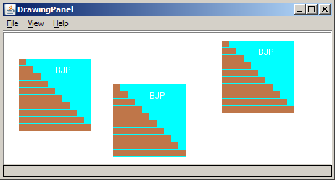
Multiple Java books
Modify the Java book program so that it can draw books at different positions as shown below.
book top/left positions: (20, 35), (150, 70), (300, 10)
drawing panel's new size: 450x180

Slide 17
Multiple books solution
To draw in a method, you must pass Graphics g to it.
// Draws many BJP textbooks using parameters.
import java.awt.*;
public class Book2 {
public static void main(String[] args) {
DrawingPanel panel = new DrawingPanel(450, 180);
panel.setBackground(Color.WHITE);
Graphics g = panel.getGraphics();
// draw three books at different locations
drawBook(g, 20, 35);
drawBook(g, 150, 70);
drawBook(g, 300, 10);
}
...

Slide 18
Multiple books, cont'd.
...
// Draws a BJP textbook at the given x/y position.
public static void drawBook(Graphics g, int x, int y) {
g.setColor(Color.CYAN); // cyan background
g.fillRect(x, y, 100, 100);
g.setColor(Color.WHITE); // white "bjp" text
g.drawString("BJP", x + 50, y + 20);
g.setColor(new Color(191, 118, 73));
for (int i = 0; i < 10; i++) { // orange "bricks"
g.fillRect(x, y + 10 * i, 10 * (i + 1), 9);
}
}
}

Slide 19
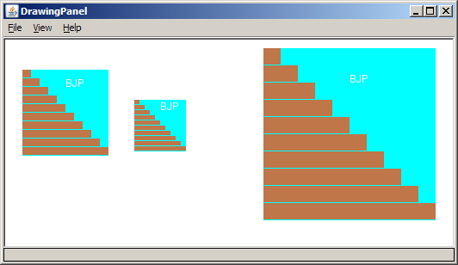
Resizable Java books
Modify the Java book program so that it can draw books at different sizes as shown below.
book sizes: 100x100, 60x60, 200x200
drawing panel's new size: 520x240

Slide 20
Resizable books solution
// Draws many sized BJP textbooks using parameters.
import java.awt.*;
public class Book3 {
public static void main(String[] args) {
DrawingPanel panel = new DrawingPanel(520, 240);
panel.setBackground(Color.WHITE);
Graphics g = panel.getGraphics();
// draw three books at different locations/sizes
drawBook(g, 20, 35, 100);
drawBook(g, 150, 70, 60);
drawBook(g, 300, 10, 200);
}
...

Slide 21
Resizable solution, cont'd.
...
// Draws a book of the given size at the given position.
public static void drawBook(Graphics g, int x, int y, int size) {
g.setColor(Color.CYAN); // cyan background
g.fillRect(x, y, size, size);
g.setColor(Color.WHITE); // white "bjp" text
g.drawString("BJP", x + size/2, y + size/5);
g.setColor(new Color(191, 118, 73));
for (int i = 0; i < 10; i++) { // orange "bricks"
g.fillRect(x, // x
y + size/10 * i, // y
size/10 * (i + 1), // width
size/10 - 1); // height
}
}
}

Slide 22
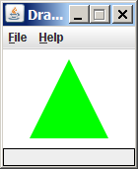
Polygon
Objects that represent arbitrary shapes
Add points to a Polygon using its addPoint(x, y) method.
Example:
DrawingPanel p = new DrawingPanel(100, 100);
Graphics g = p.getGraphics();
g.setColor(Color.GREEN);
Polygon poly = new Polygon();
poly.addPoint(10, 90);
poly.addPoint(50, 10);
poly.addPoint(90, 90);
g.fillPolygon(poly);

Slide 23
DrawingPanel methods
panel.clear(); Erases any shapes that are drawn on the drawing panel.
panel.setWidth(width); panel.setHeight(height); panel.setSize(width, height); Changes the drawing panel's size to the given value(s).
panel.save(filename); Saves the image on the panel to the given file (String).
panel.sleep(ms); Pauses the drawing for the given number of milliseconds.

Slide 24
Animation with sleep
DrawingPanel's sleep method pauses your program for a given number of milliseconds.
You can use sleep to create simple animations.
DrawingPanel panel = new DrawingPanel(250, 200);
Graphics g = panel.getGraphics();
g.setColor(Color.BLUE);
for (int i = 1; i <= 10; i++) {
g.fillOval(15 * i, 15 * i, 30, 30);
panel.sleep(500);
}
Try adding sleep commands to loops in past exercises in this chapter and watch the panel draw itself piece by piece.

